Slide 1


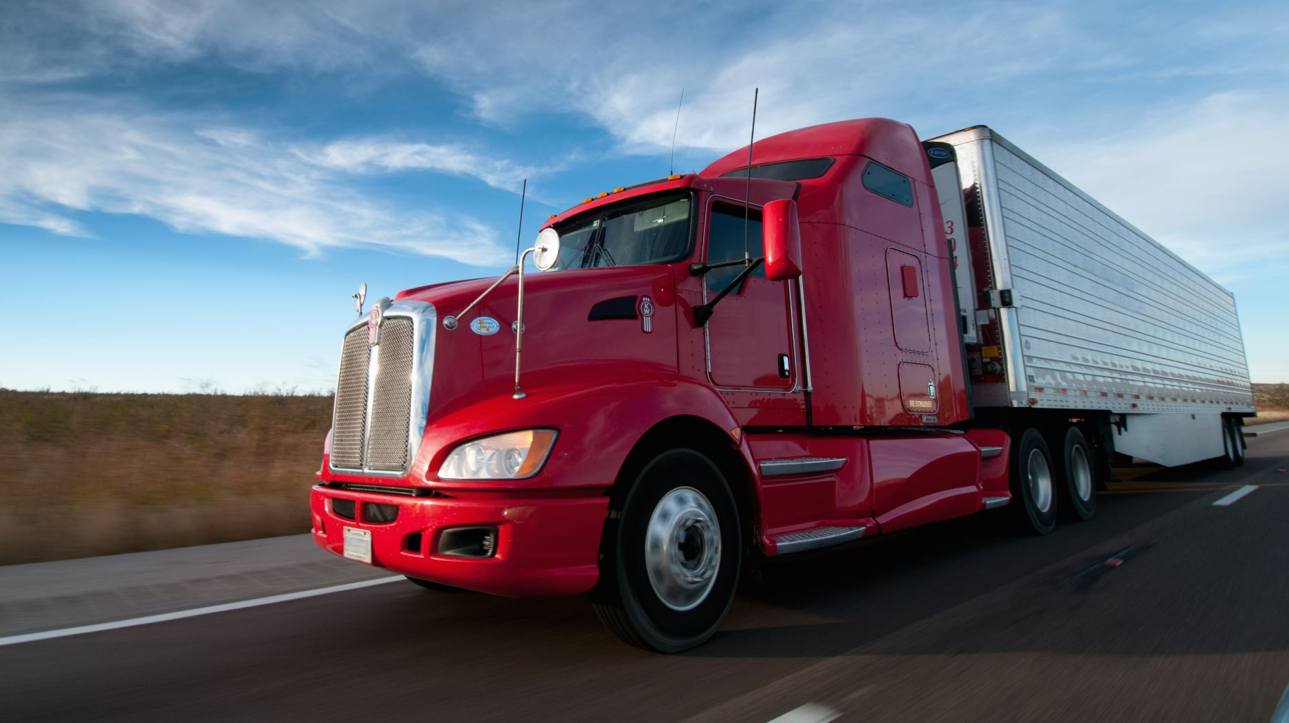

Dynamic Decision-Making in Autonomous Truck Platooning: Balancing Efficiency and Safety on Highways
PRESENTED BY:
PRANJAL GHAN - 841411410 KEERTHANA KRISHNAMURTHY - 680869871 RAKSHITHA KANDAVARA JAYARAMA - 862972326 MUKKESH MEDAI DALAVOI KUMARASWAMY - 733546104

Slide 2

OVERVIEW OF TRUCK PLATOONING
Autonomous truck platooning is the use of automated and connected technology to enable a group of trucks to travel in a closely spaced platoon on highways with minimal human intervention.
This technology leverages a combination of various advanced systems, including adaptive cruise control, automated steering and braking, and vehicle-to-vehicle (V2V) communication.
Truck platooning advances road transport by ensuring safer travels with swift, automatic braking, and promoting eco-friendliness with improved fuel efficiency that lowers CO2 emissions. The close formation of trucks reduces air resistance, optimizing road usage and easing traffic congestion.
Several countries, including the Netherlands, the United States, Germany, and Japan, are currently experimenting with truck platooning, conducting pilot tests to explore its benefits and practicality. These trials, which are still in the exploratory phase, aim to evaluate the technology's safety, efficiency, and environmental impact under different conditions.

Slide 3
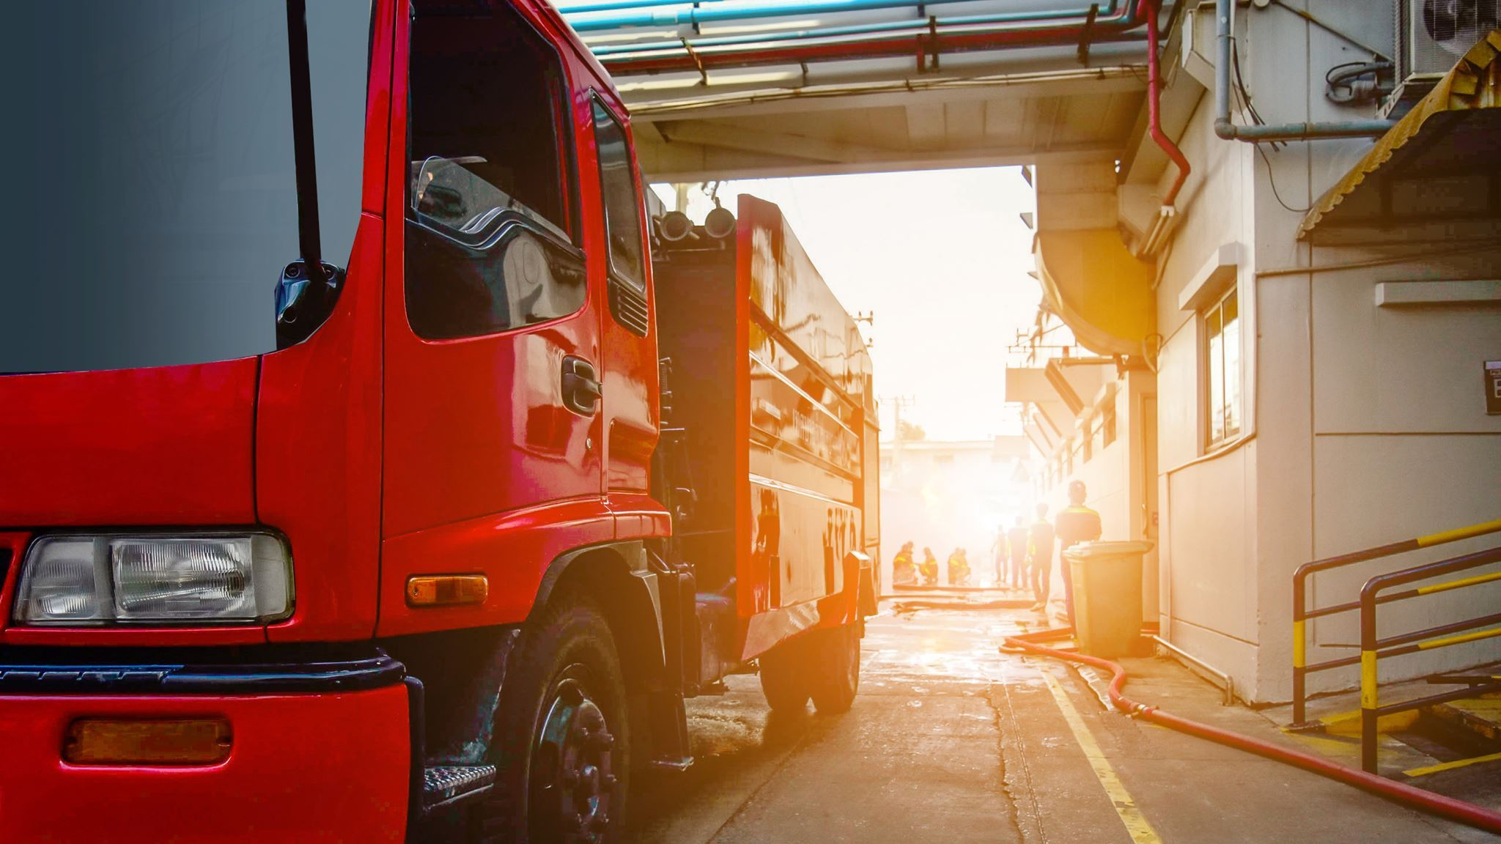
OBJECTIVE OF OUR PROJECT
The objective is to simulate truck platooning dynamics by modeling the behavior of multiple trucks in a platoon as they perform complex maneuvers such as formation, lane changes, reacting to cut-in vehicles, and emergency braking.
To explore sensor integration and decision making by illustrating how sensors and IoT technologies are utilized for real-time data gathering and processing, facilitating automated decisions within the platoon.
KEY GOALS
Simulate and evaluate various critical scenarios, to assess the safety implications of truck platooning and propose collision mitigation techniques.
Assess the impact of dynamic platoon formation and dissolution on highway logistics, focusing on traffic flow and trucking efficiency.
Demonstrate an architecture that allows trucks to function as smart agents capable of making independent decisions regarding platooning based on their surroundings and pre-set configuration parameters.

Slide 4

SIMULATION ENVIRONMENT SETUP - MATLAB
HIGHWAY MODEL:
The highway features three lanes, which are defined in the model using key parameters and calculations that establish the road's layout. Parameters like laneWidth, trackWidth, and laneMargin determine the dimensions and boundaries of these lanes.
TRUCK MODEL:
Physical Parameters:
Mass (m): 40,000 kg, indicating large, heavy vehicles likely meant to represent commercial trucks.
Gravity (g): 9.81 m/s², standard gravitational acceleration.
Drag Coefficient (Cd): 0.78, relatively high due to the less aerodynamic shape of trucks.
Frontal Area (A): 10 m², larger frontal area contributes to higher aerodynamic drag.
Air Density (rho): 1.2265 kg/m³, typical at sea level under standard conditions.

Slide 5

Physical Forces Calculated:
Drag resistance (Dx): This represents the aerodynamic drag opposing the motion of the truck.
Rolling resistance (Rx): Simplified to zero in this model, though typically it would oppose motion similar to drag but due to tire-road interaction.
Gravity force (Gx): Since the road slope is zero, the gravitational component along the road surface is zero.
Control Systems and V2V Communication:
Cruise Control (Leader Truck): The platoon leader uses cruise control with a reference speed Vr=20 m/s. The thrust force is adjusted to reduce the difference between the current speed and the desired speed.
Adaptive Cruise Control (Following Trucks): If the truck is not the leader, it uses adaptive cruise control. It calculates a desired distance from the truck ahead based on the current speed and a time gap of 1.0 second. This models a typical ACC system which aims to maintain both a safe distance and a steady speed relative to the vehicle ahead.
Sensor Inputs:
Radar is used to calculate the control force necessary for maintaining a safe following distance. Each truck will receive this information about the truck directly ahead of it and the one directly behind it. This in conjunction with distance is used to modulate speed, ensuring safe and efficient coordination within the platoon.
LiDAR is used to detect and track cars cutting in ahead of the truck by providing data on their position and trajectory. Each truck detects the presence of vehicles extraneous to the platoon and takes adaptive decision accordingly.

Slide 6

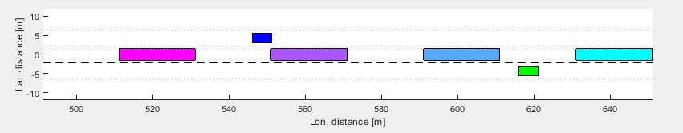
CAR MODEL:
Physical Parameters:
Mass (m): 1,500 kg, typical for a passenger vehicle.
Gravity, Drag Coefficient, Frontal Area, Air Density: Parameters are set appropriately for a smaller, more aerodynamic vehicle compared to the truck.
Physical Forces Acting on the Car:
Drag Resistance (Dx): Calculated similarly to the truck but with different parameters to reflect the car's aerodynamics.
Rolling Resistance (Rx): Also simplified to zero.
Gravity Force (Gx): Calculated similarly, based on road slope, which is zero in the given scenario.
Control System:
Cruise Control (Car): Uses a similar control system to the truck's leader, maintaining a reference speed.

Slide 7
Implementation AND DEMO
SCENARIOS
Truck platoon formation for optimal platoon spacing and safety
Trucks dynamically adjust speeds using sensors to accommodate intervening cars, maintaining platoon integrity and safe distances.
Truck platoon executes coordinated emergency braking in response to a car coming to halt, demonstrating the effectiveness of integrated collision avoidance systems in maintaining convoy safety.
Truck platoon performs a coordinated lane change to circumvent an obstacle, utilizing sensors and synchronized movements.

Slide 8

CONCLUSION
In conclusion, the journey of developing and evaluating a dynamic decision-making framework for autonomous truck platooning has been marked by significant technological advancements and operational insights. The convergence of simulation modeling, algorithmic evaluation, and economic analysis has provided a holistic view of the framework's capabilities and potential benefits.
Moving forward, continued research and development efforts will be paramount in further refining and validating the framework. This entails addressing key challenges such as scalability, regulatory compliance, and infrastructure readiness.
Collaborative endeavors between academia, industry stakeholders, and regulatory bodies will be essential in navigating these challenges and unlocking the full potential of autonomous truck platooning systems.
Ultimately, the success of this project heralds a new era in autonomous trucking, where fuel efficiency, safety, and operational excellence converge to shape the future of freight transportation.

Slide 9
THANK YOU
ANY QUESTIONS?

